Slide 1
PHY2004: Electromagnetism and Optics
Part 2: Optics
Dr. Fumin Huang
f.huang@qub.ac.uk

Slide 2
Course Contents
Polarisation of light
Types of polarisation
Linear and circular polarisation conditions
Stokes polarisation parameters Jones Vector
Faraday effect
Light reflection and refraction at a planar interface
Fresnel formulae
Brewster angle, critical angle
Total internal reflection
Phase changes during reflection
Principles of lasers
Einstein coefficients
Population inversion
Three energy level and four energy level laser systems

Slide 3
Suggested Textbooks
Polarized light, 3rd Edition, Dennis H Goldstein.
Principles of Optics, Max Born & Emil Wolf
Lasers : theory and applications, K. Thyagarajan and A.K. Ghatak

Slide 4
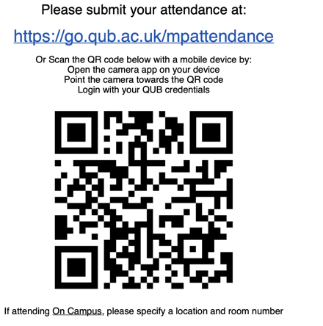

Slide 5
PHY2004: Electromagnetism and Optics
Part 2: Optics
Topic 1
Polarisation of Light

Slide 6
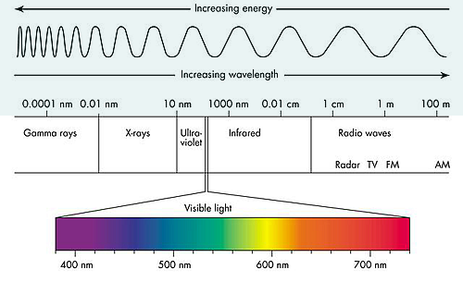
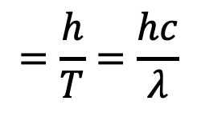
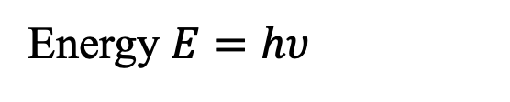
Electromagnetic Spectrum
Light is an electromagnetic wave ($λ\sim$400-700 nm).
$$=\frac{h}{T}=\frac{hc}{λ}$$
Energy $E=hυ$

Slide 7
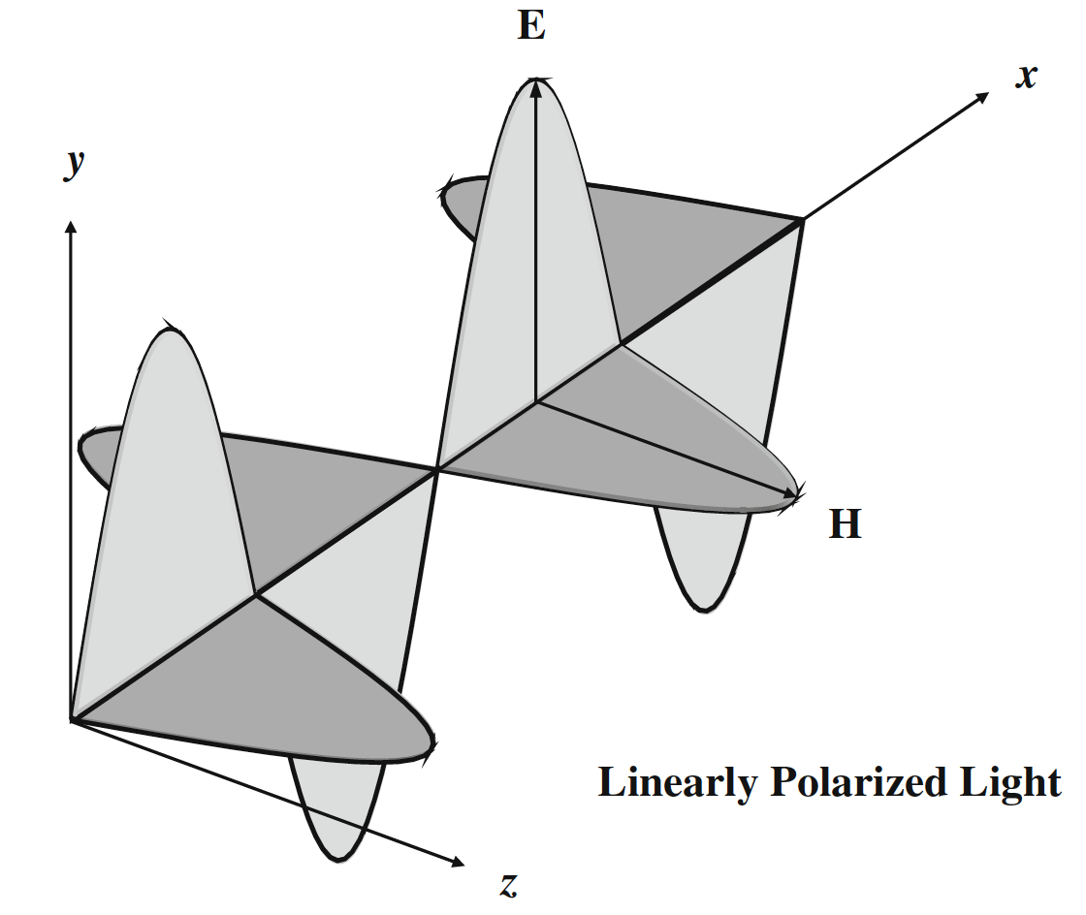
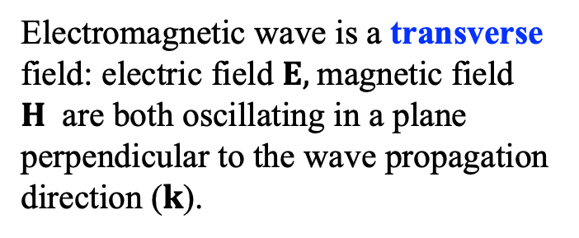
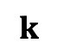
What is Polarisation?
Polarisation: a fundamental property of EM field, specifying the oscillating orientation of the E-field in space and how it evolves with time.
z
y
$$k$$
Electromagnetic wave is a transverse field: electric field $E,$magnetic field $H$ are both oscillating in a plane perpendicular to the wave propagation direction ($k$).
x

Slide 8
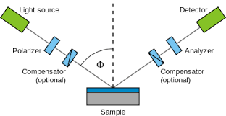
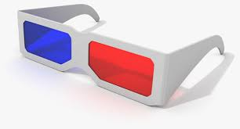
Why Need to Know Polarisation?
Polarisation is one of the fundamental properties of light, central to many optical phenomena and applications.
Light-matter interaction is polarisation-dependent, e.g., reflection, transmission, absorption, scattering, interference, birefringence, laser.
Important applications: polarizer, waveplates, 3D glasses, sunglasses, LCD display, ellipsometry etc.
Ellipsometry

Slide 9
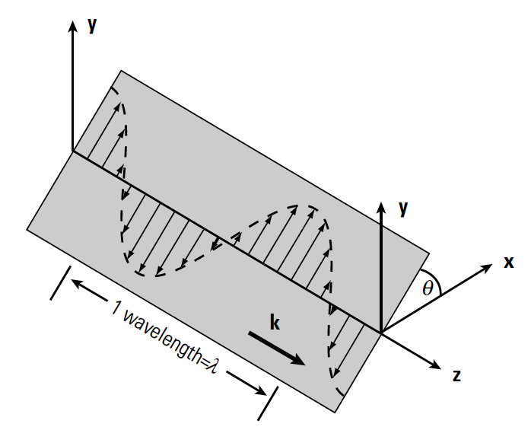
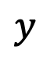
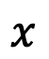
Types of Polarisation
Based on the trajectory of the tips of E-field, polarisation can be classified as:
Linear polarisation
Circular polarisation
Right-handed circular polarisation
Left-handed circular polarisation
Elliptic polarisation
Linear polarisation: E-field oscillates along a fixed orientation, which remains unchanged in time (could vary in space).
$$y$$
E(t)
$$x$$

Slide 10
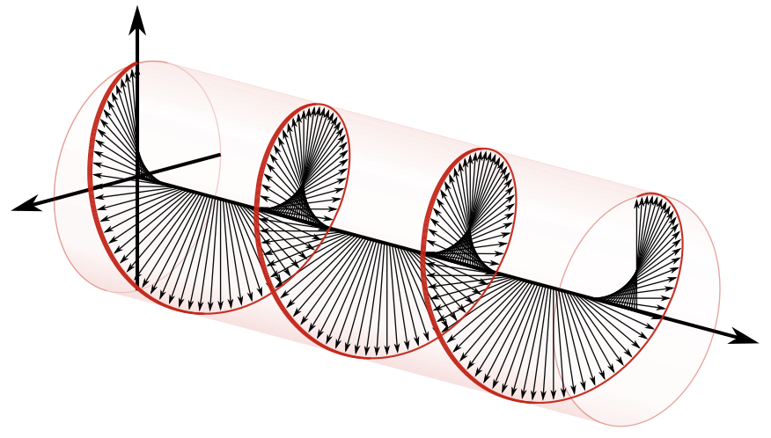
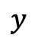
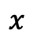
Circular Polarisation
Circular polarisation:
The orientation of E-field rotates circularly with time.
The magnitude of the field remains constant.
Right/Left-handed circular light: E-vector rotates clockwise/anticlockwise with time (viewed by the source).
From the Receiver’s view, the tip of the E-vector of right-handed circular polarisation forms a shape like a right-handed screw.
$$y$$
Left
E(t)
Right
$$x$$
Receiver
Right-handed circular polarisation

Slide 11
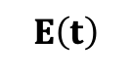
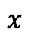
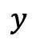
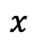
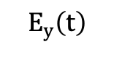
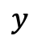
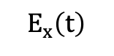
Elliptic Polarisation
Elliptic polarisation: in the general case, the tip of E-field moves along an ellipse.
Linear polarisation and circular polarisation are the special cases of elliptic polarisation (as line and circle are special shapes of ellipse)
$$E\left(t\right)$$
$$E_{y}\left(t\right)$$
$$y$$
$$y$$
$$E_{x}\left(t\right)$$
E(t)
E(t)
$$x$$
$$x$$

Slide 12
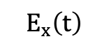
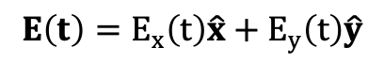
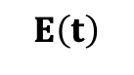
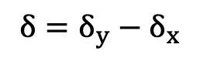
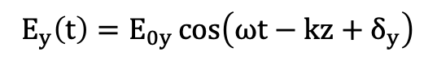
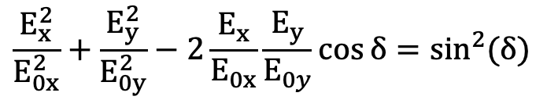
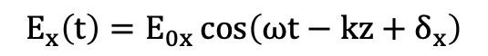
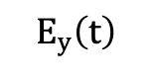
Polarisation Ellipse
$$E_{x}\left(t\right)=E_{0x}\cos\left(ωt−kz+δ_{x}\right)$$
$$E\left(t\right)$$
$$E_{y}\left(t\right)=E_{0y}\cos\left(ωt−kz+δ_{y}\right)$$
$$E_{y}\left(t\right)$$
magnitude
phase
$$E_{x}\left(t\right)$$
$${δ=δ}_{y}−δ_{x}$$
Phase difference
Ellipse Equation
$$\frac{E_{x}^{2}}{E_{0x}^{2}}+\frac{E_{y}^{2}}{E_{0y}^{2}}−2\frac{E_{x}}{E_{0x}}\frac{E_{y}}{E_{0y}}\cos{δ}=\sin^{2}(δ)$$
$$E\left(t\right)=E_{x}\left(t\right)\hat{x}+E_{y}\left(t\right)\hat{y}$$

Slide 13
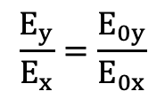
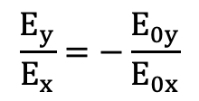
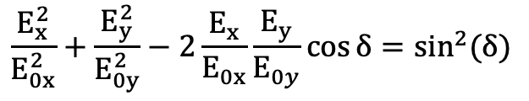
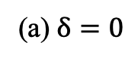
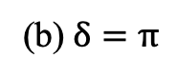
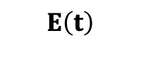
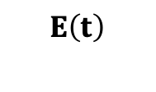
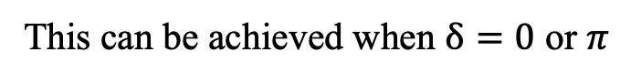
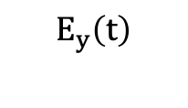
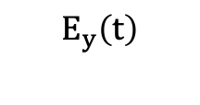
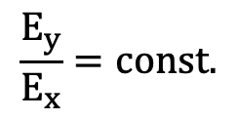
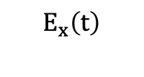
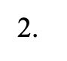
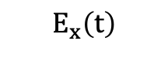
Linear Polarisation
$$\frac{E_{x}^{2}}{E_{0x}^{2}}+\frac{E_{y}^{2}}{E_{0y}^{2}}−2\frac{E_{x}}{E_{0x}}\frac{E_{y}}{E_{0y}}\cos{δ}=\sin^{2}(δ)$$
What are the conditions of linear polarisation?
1. Ordinary cases:
$E_{0y}=0,$ $E\left(t\right)=E_{x}\left(t\right)\hat{y}$, Linear horizontal polarisation
or
$E_{0x}=0,$ $E\left(t\right)=E_{y}\left(t\right)\hat{y}$, Linear vertical polarisation
$$\frac{E_{y}}{E_{x}}=const.$$
2.
This can be achieved when $δ=0$ or $π$
(a)$δ=0$
Y
(b)$δ=π$
Y
$$\frac{E_{y}}{E_{x}}=\frac{E_{0y}}{E_{0x}}$$
$$\frac{E_{y}}{E_{x}}=−\frac{E_{0y}}{E_{0x}}$$
$$E_{y}\left(t\right)$$
$$E\left(t\right)$$
$$E\left(t\right)$$
$$E_{y}\left(t\right)$$
$$E_{x}\left(t\right)$$
X
$$E_{x}\left(t\right)$$
X

Slide 14
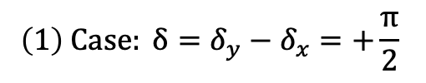
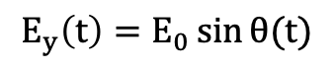
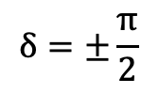
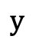
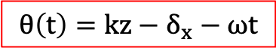
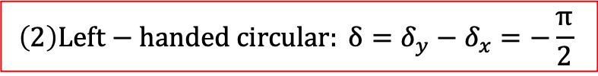









Circular Polarisation
Conditions for circular polarisation:
$$\left(1\right) Case: δ=δ_{y}−δ_{x}=+\frac{π}{2}$$
$$δ=±\frac{π}{2}$$
AND
$$E_{0x}=E_{0y}=E_{0}$$
$$E_{y}\left(t\right)=E_{0}\cos\left(ωt−kz+δ_{x}+\frac{π}{2}\right)$$
$$\frac{E_{x}^{2}}{E_{0}^{2}}+\frac{E_{y}^{2}}{E_{0}^{2}}=1$$
$$=E_{0}\sin\left[\frac{π}{2}−\left(ωt−kz+δ_{x}+\frac{π}{2}\right)\right]$$
$$=E_{0}\sin\left(kz−δ_{x}−ωt\right)$$
circle
$$E_{x}\left(t\right)=E_{0}\cos\left(ωt−kz+δ_{x}\right)$$
$$=E_{0}\cos\left(kz−δ_{x}−ωt\right)$$
$$y$$
Right or Left?
Left
E(t)
$$θ\left(t\right)=kz−δ_{x}−ωt$$
Right
$$θ(t)$$
$$E_{x}\left(t\right)=E_{0}\cos{θ(t)}$$
$$x$$
$$E_{y}\left(t\right)=E_{0}\sin{θ(t)}$$
$θ\left(t\right) d$ecreases with time, clockwise rotation: right-handed circular polarisation
$$\left(2\right)Left−handed circular: δ=δ_{y}−δ_{x}=−\frac{π}{2}$$

Slide 15
















Polarisation Ellipse
$$\frac{E_{x}^{2}}{E_{0x}^{2}}+\frac{E_{y}^{2}}{E_{0y}^{2}}−2\frac{E_{x}}{E_{0x}}\frac{E_{y}}{E_{0y}}\cos{δ}=\sin^{2}(δ)$$
$$\tan\left(2Ψ\right)=\tan{(2α)}\cos{δ}$$
$$\sin\left(2χ\right)=\sin{(2α)}\sin{δ}$$
$$a^{2}+b^{2}=E_{0x}^{2}+E_{0y}^{2}$$
$$α=\tan^{−1}\left(\frac{E_{0y}}{E_{0x}}\right)$$
E(t)
$$α$$
$$b$$
Ellipticity angle $χ:$
$$\tan{χ=±\frac{b}{a}}$$
$$χ$$
$$a$$
Line: $χ$=0
(1) $α=0$ ($E_{0y}=0$), $\frac{π}{2}$ ($E_{0x}=0$) or
(2) $δ=0, π$
The ellipse can be described by the orientation $Ψ$and ellipticity $χ$angles.
Circle: $χ=±\frac{π}{4}$
(1) $α=\frac{π}{4}$ ($E_{0x}=E_{0y}$) and
(2) $δ=±\frac{π}{2}$
$0≤Ψ<π$, $−\frac{π}{4}≤χ≤\frac{π}{4}$

Slide 16























Polarisation Ellipse
Linear polarisation
$E_{0x}=0$ or $E_{0y}=0$, or
$δ=0$ or $π$
Circular polarisation
$E_{0x}=E_{0y}$, and
$δ=\frac{π}{2}$ (right), or $δ=−\frac{π}{2}$ (left),
Other conditions: elliptic polarisation
$$E_{y}$$
$$E_{y}$$
$$E_{y}$$
$$E_{y}$$
$$E_{y}$$
$$E_{y}$$
$$E_{y}$$
$$E_{y}$$
$$E_{y}$$
$$E_{x}$$
$$E_{x}$$
$$E_{x}$$
$$E_{x}$$
$$E_{x}$$
$$E_{x}$$
$$E_{x}$$
$$E_{x}$$
$$E_{x}$$
$$δ=5π∕4$$
$$δ=7π∕4$$
$$δ=2π$$

Slide 17


Examples of Questions
1. $E_{x}\left(t\right)=A\cos{(kz−ωt)}$, $E_{y}\left(t\right)=A\sin{(ωt−kz+\frac{π}{4}+δ)}$. Describe the conditions of $δ$ ($0≤δ<2π)$ for linear, right- and left-circular polarisation, respectively.
2. Determine the polarisation states of the following cases ($A>0$)
(a) $E_{x}\left(t\right)=A\cos{(ωt−kz)}$, $E_{y}\left(t\right)=2A\cos{(ωt−kz)}$
(b) $E_{x}\left(t\right)=A\sin{(ωt−kz)}$, $E_{y}\left(t\right)=A\sin{(ωt−kz+\frac{π}{2})}$
(c) $E_{x}\left(t\right)=A\cos{(ωt−kz)}$, $E_{y}\left(t\right)=A\sin{(ωt−kz)}$
(d) $E_{x}\left(t\right)=A\sin{(ωt−kz)}$, $E_{y}\left(t\right)=A\cos{(ωt−kz)}$
(e) $E_{x}\left(t\right)=A\cos{(ωt−kz)}$, $E_{y}\left(t\right)=2A\sin{(ωt−kz)}$

Slide 18




Stokes Polarisation Parameters
How to measure and characterize the polarisation state of light?
In 1852, Lord George Stokes discovered that any polarisation state of light can be completely described by four measurable real quantities ($S_{0}$, $S_{1}$, $S_{2}$, $S_{3}$), which are called Stokes polarisation parameters.
$$S_{0}=\left\langle E_{x}(t)E_{x}^{∗}(t)\right\rangle +\left\langle E_{y}(t)E_{y}^{∗}(t)\right\rangle$$
$$S_{1}=\left\langle E_{x}(t)E_{x}^{∗}(t)\right\rangle −\left\langle E_{y}\left(t\right)E_{y}^{∗}\left(t\right)\right\rangle$$
$$S_{2}=\left\langle E_{x}(t)E_{y}^{∗}(t)\right\rangle +\left\langle E_{y}\left(t\right)E_{x}^{∗}\left(t\right)\right\rangle$$
$$S_{3}=i\left(\left\langle E_{x}(t)E_{y}^{∗}(t)\right\rangle −\left\langle E_{y}\left(t\right)E_{x}^{∗}\left(t\right)\right\rangle \right)$$
$$\left\langle E_{i}(t)E_{j}^{∗}(t)\right\rangle =\frac{1}{T}\int_{0}^{T}{E_{i}\left(t\right)E_{j}^{∗}\left(t\right)dt}$$
means time average,
T: Period of EM field; *: complex conjugate

Slide 19



Completely Polarised Light
For completely polarized light, the y- and x- component electric fields have a constant phase difference ${δ=δ}_{y}−δ_{x}$, Stokes parameters are given by
$$S_{0}=\left\langle E_{x}(t)E_{x}^{∗}(t)\right\rangle +\left\langle E_{y}(t)E_{y}^{∗}(t)\right\rangle =E_{0x}^{2}+E_{0y}^{2}$$
$$S_{1}=\left\langle E_{x}(t)E_{x}^{∗}(t)\right\rangle −\left\langle E_{y}\left(t\right)E_{y}^{∗}\left(t\right)\right\rangle =E_{0x}^{2}−E_{0y}^{2}$$
$$S_{2}=\left\langle E_{x}(t)E_{y}^{∗}(t)\right\rangle +\left\langle E_{y}\left(t\right)E_{x}^{∗}\left(t\right)\right\rangle =2E_{0x}E_{0y}\cos{δ}$$
$$S_{3}=i\left(\left\langle E_{x}(t)E_{y}^{∗}(t)\right\rangle −\left\langle E_{y}\left(t\right)E_{x}^{∗}\left(t\right)\right\rangle \right)=2E_{0x}E_{0y}\sin{δ}$$
$$S_{0}^{2}=S_{1}^{2}+S_{2}^{2}+S_{3}^{2}$$
Knowing the Stokes parameters, $E_{0x}, E_{0y} and δ$ can be worked out, therefore the polarization state of light can be completely determined.

Slide 20



Generally, we can write $E_{x}\left(t\right)$ and $E_{y}\left(t\right)$ in complex term
$$E_{x}\left(t\right)=E_{0x}e^{i(ωt−kz+δ_{x})}$$
$$E_{y}\left(t\right)=E_{0y}e^{i(ωt−kz+δ_{y})}=E_{0y}e^{i(ωt−kz+δ_{x}+δ)}$$
$$\left\langle E_{x}(t)E_{x}^{∗}(t)\right\rangle =\frac{1}{T}\int_{0}^{T}{E_{x}\left(t\right)E_{x}^{∗}\left(t\right)dt}=\frac{1}{T}\int_{0}^{T}{E_{0x}e^{i(ωt−kz+δ_{x})}E_{0x}e^{−i(ωt−kz+δ_{x})}dt}$$
$$=\frac{1}{T}\int_{0}^{T}{E_{0x}^{2}dt}=E_{0x}^{2}$$
$$\left\langle E_{y}(t)E_{y}^{∗}(t)\right\rangle =E_{0y}^{2}$$
$$S_{0}=\left\langle E_{x}(t)E_{x}^{∗}(t)\right\rangle +\left\langle E_{y}(t)E_{y}^{∗}(t)\right\rangle =E_{0x}^{2}+E_{0y}^{2}$$
Intensity
$$S_{1}=\left\langle E_{x}(t)E_{x}^{∗}(t)\right\rangle −\left\langle E_{y}\left(t\right)E_{y}^{∗}\left(t\right)\right\rangle =E_{0x}^{2}−E_{0y}^{2}$$

Slide 21





$E_{x}\left(t\right)=E_{0x}e^{i(ωt−kz+δ_{x})}$,
$$E_{y}\left(t\right)=E_{0y}e^{i(ωt−kz+δ_{x}+δ)}$$
$$S_{2}=\left\langle E_{x}(t)E_{y}^{∗}(t)\right\rangle +\left\langle E_{y}\left(t\right)E_{x}^{∗}\left(t\right)\right\rangle$$
$$\left\langle E_{x}(t)E_{y}^{∗}(t)\right\rangle =\frac{1}{T}\int_{0}^{T}{E_{0x}e^{i(ωt−kz+δ_{x})}E_{0y}e^{−i(ωt−kz+δ_{x}+δ)}dt}$$
$$=\frac{E_{0x}E_{0y}}{T}\int_{0}^{T}{e^{−iδ}dt}=E_{0x}E_{0y}e^{−iδ}$$
$$\left\langle E_{y}\left(t\right)E_{x}^{∗}\left(t\right)\right\rangle =\frac{1}{T}\int_{0}^{T}{E_{0y}e^{i(ωt−kz+δ_{x}+δ)}E_{0x}e^{−i(ωt−kz+δ_{x})}dt}=E_{0x}E_{0y}e^{iδ}$$
$$S_{2}=\left\langle E_{x}(t)E_{y}^{∗}(t)\right\rangle +\left\langle E_{y}\left(t\right)E_{x}^{∗}\left(t\right)\right\rangle =E_{0x}E_{0y}\left(e^{−iδ}+e^{iδ}\right)=2E_{0x}E_{0y}\cos{δ}$$
Similarly,
$$S_{3}=i\left(\left\langle E_{x}(t)E_{y}^{∗}(t)\right\rangle −\left\langle E_{y}\left(t\right)E_{x}^{∗}\left(t\right)\right\rangle \right)=2E_{0x}E_{0y}\sin{δ}$$

Slide 22









Stokes Parameters
1. Linear horizontal polarisation (LHP): $E_{0y}=0$
$S_{0}=S_{1}=E_{0x}^{2}$, $S_{2}=S_{3}=0$
2. Linear vertical polarisation (LVP): $E_{0x}=0$
$S_{0}=S_{1}=E_{0y}^{2}$, $S_{2}=S_{3}=0$
3. Linear +45° polarisation: ${E_{0x}=E}_{0y}=E_{0},δ$=0
$S_{0}=2E_{0}^{2},S_{1}=0$, $S_{2}=2E_{0}^{2}$, $S_{3}=0$
4. Linear -45° polarisation: ${E_{0x}=E}_{0y}=E_{0},δ$=$π$
$S_{0}=2E_{0}^{2},S_{1}=0$, $S_{2}=−2E_{0}^{2}$, $S_{3}=0$
5. Right-handed circular polarisation (RCP): ${E_{0x}=E}_{0y}=E_{0},δ=\frac{π}{2}$
$S_{0}=2E_{0}^{2},S_{1}=0$, $S_{2}=$0, $S_{3}=2E_{0}^{2}$
6. Left-handed circular polarisation (LCP): ${E_{0x}=E}_{0y}=E_{0},δ=−\frac{π}{2}$
$S_{0}=2E_{0}^{2},S_{1}=0$, $S_{2}=$0, $S_{3}=−2E_{0}^{2}$

Slide 23










Unpolarised Light
$$E_{x}\left(t\right)=E_{0}e^{i[ωt−kz+δ_{x}\left(t\right)]}$$
Random phases
$δ_{x}\left(t\right)$ and $δ_{y}\left(t\right)$ are unrelated
$$E_{y}\left(t\right)=E_{0}e^{i[ωt−kz+δ_{y}(t)]}$$
$$\left\langle E_{x}(t)E_{x}^{∗}(t)\right\rangle =E_{0}^{2}$$
$$\left\langle E_{y}(t)E_{y}^{∗}(t)\right\rangle =E_{0}^{2}$$
$$S_{0}=\left\langle E_{x}(t)E_{x}^{∗}(t)\right\rangle +\left\langle E_{y}(t)E_{y}^{∗}(t)\right\rangle =2E_{0}^{2}$$
$As δ\left(t\right) is a$random function of t, so
$$\int_{0}^{T}{e^{−iδ(t)}dt=0}$$
$$S_{1}=\left\langle E_{x}(t)E_{x}^{∗}(t)\right\rangle −\left\langle E_{y}\left(t\right)E_{y}^{∗}\left(t\right)\right\rangle =0$$
$$\left\langle E_{x}(t)E_{y}^{∗}(t)\right\rangle =\frac{1}{T}\int_{0}^{T}{E_{0}e^{i(ωt−kz+δ_{x}(t))}E_{0}e^{−i(ωt−kz+δ_{y}(t))}dt}=\frac{E_{0}^{2}}{T}\int_{0}^{T}{e^{−iδ(t)}dt}=0$$
Similarly, $\left\langle E_{y}(t)E_{x}^{∗}(t)\right\rangle =0$, therefore $S_{2}=S_{3}=0$

Slide 24






Polarised and Unpolarized Light
$S_{0}=E_{0x}^{2}+E_{0y}^{2}={|E|}^{2}$ represents the total intensity of light
For completely polarized light:
$$S_{0}^{2}=S_{1}^{2}+S_{2}^{2}+S_{3}^{2}$$
For unpolarized light:
$$S_{0}>0, S_{1}=S_{2}=S_{3}=0$$
In general:
$$S_{0}^{2}≥S_{1}^{2}+S_{2}^{2}+S_{3}^{2}$$
‘=‘ condition is matched for completely polarized light
Intensity of completely polarized light: $I_{p}=\sqrt{S_{1}^{2}+S_{2}^{2}+S_{3}^{2}}$
Intensity of unpolarized light: $I_{u}=S_{0}−\sqrt{S_{1}^{2}+S_{2}^{2}+S_{3}^{2}}$
$$I_{tot}=S_{0}=I_{p}+I_{u}$$
Stokes parameters can be used to separate the unpolarized and polarized parts of light

Slide 25





Degree of Polarisation
Degree of polarisation: the ratio of polarized light to the total intensity
$$P=\frac{I_{p}}{I_{tot}}=\frac{\sqrt{S_{1}^{2}+S_{2}^{2}+S_{3}^{2}}}{S_{0}}$$
$$(0≤P≤1)$$
$P=1$Completely polarised light
$P=0 U$npolarised light
$$0<P<1 Partially polarised light$$

Slide 26














Measurement of Stokes Parameters
S₀, S₁ and S₂ can be measured with a polarizer and a detector.
Assuming the polarizer has an angle $θ$ with regard to the x-axis.
The transmitted field from $E_{x}\left(t\right)$ is
$$E_{y}\left(t\right)=E_{0y}e^{i(ωt−kz+δ_{x}+δ)}$$
$$E_{x}\left(t\right)=E_{0x}e^{i(ωt−kz+δ_{x})}$$
$$E_{p}^{(x)}=E_{x}\left(t\right)\cos{θ}$$
The transmitted field from $E_{y}\left(t\right)$ is
$$E_{p}^{(y)}=E_{y}\left(t\right)\sin{θ}$$
$$y$$
Transmission axis of polariser
The total transmitted field is
$$E_{y}$$
$$E_{p}^{(y)}$$
$$E_{p}(θ)=E_{p}^{(x)}+E_{p}^{(y)}=E_{x}\left(t\right)\cos{θ}+E_{y}\left(t\right)\sin{θ}$$
$$E_{p}^{(x)}$$
The intensity measured by detector is
$$θ$$
$$E_{x}$$
$$x$$
$$I_{D}\left(θ\right)=\left\langle E_{p}(θ)E_{p}^{∗}(θ)\right\rangle$$

Slide 27









Measurement of Stokes Parameters
The measured intensity is
$$I_{D}\left(θ\right)=<E_{p}(θ)E_{p}^{∗}(θ)>$$
$$E_{p}(θ)=E_{p}^{(x)}+E_{p}^{(y)}=E_{x}\left(t\right)\cos{θ}+E_{y}\left(t\right)\sin{θ}$$
$$I_{D}\left(θ\right)=\left\langle (E_{x}\cos{θ}+E_{y}\sin{θ})(E_{x}^{∗}\cos{θ}+E_{y}^{∗}\sin{θ})\right\rangle$$
$$=\left\langle E_{x}E_{x}^{∗}\cos^{2}{θ}+{E_{x}E_{y}^{∗}\sin{θ\cos{θ}+}E}_{y}E_{x}^{∗}\sin{θ\cos{θ}+}E_{y}E_{y}^{∗}\sin^{2}{θ}\right\rangle$$
(eq.1)
$$\left(1\right) θ=0°,$$
$I_{D}\left(0°\right)=\left\langle E_{x}E_{x}^{∗}\right\rangle$= $E_{0x}^{2}$
$$S_{0}=I_{D}\left(0°\right)+I_{D}\left(90°\right)$$
$$\left(2\right) θ=90°,$$
$I_{D}\left(90°\right)=\left\langle E_{y}E_{y}^{∗}\right\rangle$= $E_{0y}^{2}$
$$S_{1}=I_{D}\left(0°\right)−I_{D}\left(90°\right)$$
$$I_{D}\left(45°\right)=\frac{1}{2}\left\langle E_{x}E_{x}^{∗}+E_{x}E_{y}^{∗}+E_{y}E_{x}^{∗}+E_{y}E_{y}^{∗}\right\rangle =\frac{1}{2}\left(S_{0}+S_{2}\right)$$
$$\left(3\right) θ=45°,$$
$$S_{2}={2I}_{D}\left(45°\right)−S_{0}={2I}_{D}\left(45°\right)−I_{D}\left(0°\right)−I_{D}\left(90°\right)$$

Slide 28





Measurement of S₃
S₃ can be measured with the combination of a waveplate and a polarizer.
A waveplate introduces a phase difference of $φ$ between the x- and y-components of E-field, i.e., after the waveplate,
$E_{x}^{′}\left(t\right)=E_{x}\left(t\right)e^{iφ}$, $E_{y}^{′}\left(t\right)=E_{y}\left(t\right)$
$$E_{y}\left(t\right)$$
$$E_{x}\left(t\right)$$
$$E_{y}^{′}\left(t\right)$$
$$E_{x}^{′}\left(t\right)$$
The intensity measured by the detector is (this can be obtained by replacing the $E_{x}$ and $E_{y}$in Eq.1 in slide 27 with $E_{x}^{′}=E_{x}e^{iφ}$and${ E}_{y}^{′}=E_{y}$)
$$I_{D}\left(θ,φ\right)=\left\langle E_{x}^{′}E_{x}^{′∗}\cos^{2}{θ}+E_{x}^{′}E_{y}^{′∗}\sin{θ\cos{θ}}+E_{y}^{′}E_{x}^{′∗}\sin{θ\cos{θ}}+E_{y}^{′}E_{y}^{′∗}\sin^{2}{θ}\right\rangle$$
$$=\left\langle E_{x}^{′}E_{x}^{′∗}\right\rangle \cos^{2}{θ}+\left\langle E_{x}^{′}E_{y}^{′∗}+E_{y}^{′}E_{x}^{′∗}\right\rangle \sin{θ\cos{θ}}+\left\langle E_{y}^{′}E_{y}^{′∗}\right\rangle \sin^{2}{θ}$$

Slide 29





Measurement of S₃
$$I_{D}\left(θ,φ\right)=\left\langle E_{x}^{′}E_{x}^{′∗}\right\rangle \cos^{2}{θ}+\left\langle E_{x}^{′}E_{y}^{′∗}+E_{y}^{′}E_{x}^{′∗}\right\rangle \sin{θ\cos{θ}}+\left\langle E_{y}^{′}E_{y}^{′∗}\right\rangle \sin^{2}{θ}$$
$\left\langle E_{x}^{′}E_{x}^{′∗}\right\rangle =$ $E_{0x}^{2}$
$$\left\langle E_{y}^{′}E_{y}^{′∗}\right\rangle =E_{0y}^{2}$$
$$\left\langle E_{x}^{′}E_{y}^{′∗}+E_{y}^{′}E_{x}^{′∗}\right\rangle =\left\langle E_{x}e^{iφ}E_{y}^{∗}+{E_{y}E_{x}^{∗}e}^{−iφ}\right\rangle$$
$$e^{iφ}=\cos{φ+i\sin{φ}}$$
$$e^{−iφ}=\cos{φ−i\sin{φ}}$$
$$\left\langle E_{x}^{′}E_{y}^{′∗}+E_{y}^{′}E_{x}^{′∗}\right\rangle =\left\langle E_{x}E_{y}^{∗}\left(\cos{φ+i\sin{φ}}\right)+E_{y}E_{x}^{∗}(\cos{φ−i\sin{φ}})\right\rangle$$
$$=\left\langle E_{x}E_{y}^{∗}+E_{y}E_{x}^{∗}\right\rangle \cos{φ}+i\left\langle E_{x}E_{y}^{∗}−E_{y}E_{x}^{∗}\right\rangle \sin{φ}$$
$$=S_{2}\cos{φ}+S_{3}\sin{φ}$$
$$I_{D}\left(θ,φ\right){=E}_{0x}^{2}\cos^{2}{θ}+S_{2}\cos{φ}\sin{θ\cos{θ}}+S_{3}\sin{φ}\sin{θ\cos{θ}}+E_{0y}^{2}\sin^{2}{θ}$$
$$I_{D}\left(45°,90°\right){=\frac{1}{2}(E}_{0x}^{2}+S_{3}+E_{0y}^{2})=\frac{1}{2}(S_{0}+S_{3})$$
$$S_{3}=2I_{D}\left(45°,90°\right)−S_{0}$$

Slide 30











Determine the polarisation states from Stokes parameters
Intensity of unpolarized light: $I_{u}=S_{0}−\sqrt{S_{1}^{2}+S_{2}^{2}+S_{3}^{2}}$
Intensity of polarized light: $I_{p}=\sqrt{S_{1}^{2}+S_{2}^{2}+S_{3}^{2}}$
$$P=\frac{I_{p}}{I_{tot}}=\frac{\sqrt{S_{1}^{2}+S_{2}^{2}+S_{3}^{2}}}{S_{0}}$$
Degree of polarisation:
For the completely polarised component
$$E_{0x}=\sqrt{\frac{\sqrt{S_{1}^{2}+S_{2}^{2}+S_{3}^{2}}+S_{1}}{2}}$$
$$I_{p}=\sqrt{S_{1}^{2}+S_{2}^{2}+S_{3}^{2}}=E_{0x}^{2}+E_{0y}^{2}$$
$$S_{1}=E_{0x}^{2}−E_{0y}^{2}$$
$$E_{0y}=\sqrt{\frac{\sqrt{S_{1}^{2}+S_{2}^{2}+S_{3}^{2}}−S_{1}}{2}}$$
$$S_{2}=2E_{0x}E_{0y}\cos{δ}$$
$$S_{3}=2E_{0x}E_{0y}\sin{δ}$$
$E_{0x}{, E}_{0y}$ and $δ$ can be completely determined, hence the polarisation ellipse.
$$\tan{δ=\frac{S_{3}}{S_{2}}}$$

Slide 31


Waveplate
A waveplate is usually made of a slice of crystal, which is used to induce a phase difference for polarisations along its fast and slow axes, as the refractive indices are different for polarisations along the two axes.
Crystals have anisotropic optical properties. The refractive index is dependent on the polarisation orientation. There exists two axes, one is called fast axis with refractive index ($n_{0}$), the other is called slow axis with a different refractive index ($n_{e}$). This phenomenon is called birefringence.
(o-wave)
$$E_{y}$$
E
$$∆φ=\frac{2π|{n_{0}−n}_{e}|d}{λ}$$
(e-wave)
Phase difference
$$E_{x}$$
Quarter wave plate$: ∆φ=\frac{π}{2}+2mπ$ ($m$: integer)
$$d$$
Half wave plate: $∆φ=π+2mπ$

Slide 32







Polarisation Transformation
Linear polarization can be transformed to circular polarization by passing through a quarter waveplate which introduces a $±\frac{π}{2}$ phase change between the x- and y-component fields. Vice versa, circular polarization light can be converted to linear polarization by passing through a quarter waveplate.
Linear polarisation orientated 45° to the axis of waveplate, so that $E_{0x}=E_{0y}$
Slow axis
$$δ^{′}=±\frac{π}{2}$$
$$∆δ=±\frac{π}{2}$$
$$δ=0, π$$
$$E_{0x}=E_{0y}$$

Slide 33


The Faraday Effect
The Faraday effect or Faraday rotation is a magneto-optical phenomenon discovered by Faraday in 1845.
A linearly-polarised plane wave will rotate its plane-of-polarisation after passing through a piece of material, when a magnetic field along the light propagation direction is applied .
The rotation is linearly proportional to the magnetic field and the thickness of the material.
Rotated polarisation angle
$$θ=VBd$$
$V$: Verdet constant

Slide 34












Magneto-Optic Effect
A linear polarisation can be decomposed into equal proportion of right- and left-circular polarisation
Forces experienced by electrons
(1) E-field force
$$F_{e}=−e\left(−E\right)=eE$$
E
(2) Restoring force
$$F_{R}=kr=mω_{0}^{2}r$$
(3) Lorentz force
$$F_{B}=−ev×B$$
$$F_{B}$$
$$F_{e},$$
$$F_{R}$$
$$F_{e}$$
E_{R}
$$F_{B}^{R,L}=±evB=±eBωr$$
E_{L}
v
v
$$F_{B}$$
$$F_{R}$$
B
$$eE_{R,L}±eωBr+mω_{0}^{2}r=mω^{2}r$$
$$⊗$$
$$r_{R,L}=\frac{eE_{R,L}/m}{ω^{2}−ω_{0}^{2}∓eωB/m}$$
Assuming the forces pointing towards the circle centre is positive
With applied magnetic field, electrons move on circles of different radius for right and left circular polarisations

Slide 35









Circular Birefringence
Total induced dipole moment per unit volume
Refractive index
Number of electrons per unit volume
$$n=\sqrt{ε_{r}}$$
$$P=Ner=\frac{Ne^{2}E_{R,L}/m}{ω^{2}−ω_{0}^{2}∓eωB/m}$$
$$n_{R}=\sqrt{1+\frac{ω_{p}^{2}}{ω^{2}−ω_{0}^{2}−eωB/m}}$$
Relative permittivity
$$n_{L}=\sqrt{1+\frac{ω_{p}^{2}}{ω^{2}−ω_{0}^{2}+eωB/m}}$$
$$=1+\frac{\frac{Ne^{2}}{mε_{0}}}{ω^{2}−ω_{0}^{2}∓eωB/m}$$
$$ε_{r}^{R,L}=1+\frac{P}{ε_{0}E_{R,L}}$$
$$=1+\frac{ω_{p}^{2}}{ω^{2}−ω_{0}^{2}∓eωB/m}$$
$$n_{R}≠n_{L}$$
The refractive indices of right and left-circular polarisation are different, which is called circular birefringence.
$$ω_{p}=\sqrt{\frac{Ne^{2}}{mε_{0}}}$$
Plasma frequency

Slide 36









Polarisation Rotation
$$E_{R}^{′}\left(t\right)=\frac{1}{2}E_{0}\left\{\cos\left(ωt−k_{R}d\right)\hat{x}+\cos\left(ωt−k_{R}d+\frac{π}{2}\right)\hat{y}\right\}$$
$$=\frac{1}{2}E_{0}\left\{\cos\left(ωt−n_{R}k_{0}d\right)\hat{x}+\cos\left(ωt−n_{R}k_{0}d+\frac{π}{2}\right)\hat{y}\right\}$$
$$E_{L}^{′}\left(t\right)=\frac{1}{2}E_{0}\left\{\cos\left(ωt−n_{L}k_{0}d\right)\hat{x}+\cos\left(ωt−n_{L}k_{0}d−\frac{π}{2}\right)\hat{y}\right\}$$
$$E^{′}\left(t\right)=E_{R}^{′}\left(t\right)+E_{L}^{′}\left(t\right)$$
$$E^{′}\left(t\right)$$
$=E_{0}\cos\left(ωt−\frac{k_{R}+k_{L}}{2}d\right)\{\cos\left(\frac{n_{R}−n_{L}}{2}k_{0}d\right)$ $\hat{x}$
$+\sin\left(\frac{n_{R}−n_{L}}{2}k_{0}d\right)\hat{y}$}
$$E\left(t\right)$$
$$θ=\frac{n_{R}−n_{L}}{2}k_{0}d=VBd$$
$$V=\frac{n_{R}−n_{L}}{2B}k_{0}=\frac{π(n_{R}−n_{L})}{Bλ}$$

Slide 37











Verdet Constant
$$V=\frac{n_{R}−n_{L}}{2B}k_{0}$$
$$n(ω∓Δω)≈n(ω)∓Δω\frac{dn}{dω}$$
$$n_{R,L}(ω)=\sqrt{1+\frac{ω_{p}^{2}}{ω^{2}−ω_{0}^{2}∓eωB/m}}$$
$$n_{R}−n_{L}=−2Δω\frac{dn}{dω}=−\frac{eB}{m}\frac{dn}{dω}$$
$$V=\frac{π(n_{R}−n_{L})}{Bλ}=−\frac{eπ}{mλ}\frac{dn}{dω}$$
$$≈\sqrt{1+\frac{ω_{p}^{2}}{{\left(ω∓\frac{eB}{2m}\right)}^{2}−ω_{0}^{2}}}=n(ω∓Δω)$$
$$ω=\frac{2πc}{λ}$$
$$n(ω)=\sqrt{1+\frac{ω_{p}^{2}}{ω^{2}−ω_{0}^{2}}}$$
$$\frac{dn}{dω}=\frac{\frac{dn}{dλ}}{\frac{dω}{dλ}}=−\frac{λ^{2}}{2πc}\frac{dn}{dλ}$$
$$Δω=\frac{eB}{2m}$$
$$V=\frac{eλ}{2mc}\frac{dn}{dλ}$$

Slide 38

Optical Isolator
Optical isolator is an optical element which allows light transmit, but blocks the back-reflection light. It is used to prevent hazardous back-reflection beam.
Mirror
Two polarisers are orientated 45° to each other. A magnetic field is applied to rotate the polarisation of linearly-polarized light by 45° so that light can completely transmit through the second polariser.
When the reflected light passes through the Faraday rotator, its polarisation is rotated by another 45° so that it is 90° to the axis of the first polariser, hence is blocked.

